Slide 1




10 – Merge Conflicts
COMP 190 – Dickinson College
Fall 2021
https://www.youtube.com/watch?v=Tyd0FO0tko8
Images from:
https://git-scm.com/downloads/logos
https://github.com/logos
Notes:
BEFORE CLASS:
- Need to merge the conflict branch right before class.
- This branch will change all of the lines that are touched by the round2 issues.
- That will change everyone’s PR from
- can be merged automatically
- to contains conflicts.
In the activity due today you
-addressed another issue
- adding a link to the README
- made a pull request for that change to the upstream.
Today we’ll do a quick overview of how you got there.
Then we will see
- What can happen when multiple changes conflict.
- We have been careful to this point to ensure that each change was independent.
- So your change did not affect anyone else's
- And theirs did not affect yours.
- But clearly with multiple people working asynchronously in a distributed community
- it is possible that concurrent changes
- by different people
- will interact in was that conflict.
- When we try to bring those changes together
- They create what is called a merge conflict.

Slide 2
Our State at the End of A09
How did we
get here?
Commit
Pull Request
Synch
Switch
Branch
Push
Stage
Edit
Notes:
This is where things stand after you have completed A09
How did we get here?
- Discuss with your neighbors…
- Place this list of terms into a plausible order.
Build the list on the board:
1. Synch
2. Branch
3. Switch
4. Edit
5. Stage
6. Commit
7. Push
8. Pull request
Note that all developers might be doing the same thing.

Slide 3
Our State at the End of A09
Demo: Look at the Pull Requests on GitHub
Notes:
This is where you were when you made your PR.
- When you finished A09 your PR should have said
- can be merged automatically.
- From this picture that should make sense
- your blue commit (and the fuchsia and lime ones too)
- all can be applied directly on the green one
- which is still at the head of the main branch.
But if we look at your PR’s now…
- They will say “This branch has conflicts that must be resolved”
Why/How did that happen?
- next slide.

Slide 4
Upstream Changes
✓
Why is there now a conflict?
Notes:
This is the state of the world now…
- What has happened?
- Maintainers (me) merged a pull request into main
- the Fuchsia commit was added.
Ask: Why do you think it created conflict?
- Just get at the idea that the blue (or lime) commit
- must have changed the same parts of the repo
- i.e. the same area of a file.
- Don’t need to be too precise here.
Truth:
- I merged a commit that changed
- all four lines that were affected by the round 2 issues.
- so that commit will create a merge conflict for everyone

Slide 5
Merging Branches: Common Ancestors
Old MacDonald had a farm
And on that farm, he had a pig
With an oink oink here
And an oink oink there
Old MacDonald had a farm
And on that farm, he had a duck
With a quack quack here
And a quack quack there
Old MacDonald had a farm
And on that farm, he had a cow
With a moo moo here
And a moo moo there
Old MacDonald had a farm
And on that farm, he had a duck
With a quack quack here
And a quack quack there
Old MacDonald had a farm
And on that farm, he had a cow
With a moo moo here
And a moo moo there
Old MacDonald had a farm
And on that farm, he had a goat
With a bahh bahh here
And a bahh bahh there
Feature Branch
Best Common Ancestor
Main Branch
Notes:
Let’s have a little closer look at the merge process
- to understand why there were no conflicts last time
- why there are conflicts this time
- and give us a foundation for understanding how we resolve them.
Here we want to merge (or blend) the changes in
- the feature branch – blue commit
- the upstream main branch – fuchsia commit
The way this works is that git uses the history to find the best common ancestor
- The best common ancestor is the most recent shared ancestor.
Ask:
- Which commits here are common ancestors?
- red, yellow, green
- Which one is the best (i.e. most recent)?
- green

Slide 6
Merging Branches: Identifing Changes
Non-conflicting changes can be merged automatically.
Old MacDonald had a farm
And on that farm, he had a pig
With an oink oink here
And an oink oink there
Old MacDonald had a farm
And on that farm, he had a duck
With a quack quack here
And a quack quack there
Old MacDonald had a farm
And on that farm, he had a cow
With a moo moo here
And a moo moo there
Old MacDonald had a farm
And on that farm, he had a duck
With a quack quack here
And a quack quack there
Old MacDonald had a farm
And on that farm, he had a cow
With a moo moo here
And a moo moo there
Old MacDonald had a farm
And on that farm, he had a goat
With a bahh bahh here
And a bahh bahh there
Feature Branch
Best Common Ancestor
Main Branch
Notes:
Next
- git will compare the branches to the best common ancestor
- and identify the changes that have occurred in each
The changes can be:
- Non-conflicting
- Conflicting
Ask:
- Do you think the current changes are conflicting or non-conflicting?
- why?
Ask:
- What would be conflicting changes?
- if blue had changed duck or quack.
- if fuchsia had changed cow or moo
The idea of conflicting and non-conflicting changes is
- intuitively simple
- roughly… not on the same line
- much more complicated in practice
- we will not go into it…
- there is a link or two in the activity if you are interested in the details
- git’s recursive merge strategy (default)
- https://git-scm.com/docs/merge-strategies
Non-conflicting changes can be merged automatically.
- The managers of the upstream will do this
- It is what we saw last week.

Slide 7
Merge Commits
A
merge commit adds or blends changes from two parents.
Time
main
hasPig
Old MacDonald had a farm
And on that farm, he had a pig
With an oink oink here
And an oink oink there
Old MacDonald had a farm
And on that farm, he had a duck
With a quack quack here
And a quack quack there
Old MacDonald had a farm
And on that farm, he had a pig
With an oink oink here
And an oink oink there
Old MacDonald had a farm
And on that farm, he had a goat
With a bahh bahh here
And a bahh bahh there
Old MacDonald had a farm
And on that farm, he had a cow
With a moo moo here
And a moo moo there
Old MacDonald had a farm
And on that farm, he had a goat
With a bahh bahh here
And a bahh bahh there
7
Feature Branch
Merged Result
Main Branch
7
Notes:
When two branches are merged
- A merge commit is added to the target branch
- In this case we are showing an automatic merge
- of a feature branch into the main branch.
When changes don’t conflict
- and the merge happens automatically
- the merge commit will just add the changes from the feature branch
But, as we will see if the changes conflict
- then the merge commit may
- pick one or the other
- or blend the changes
Having a merge commit makes it clear where the changes came from.
- part of the history.
- preserves the fact that a branch was merged
- where the branch came from
- what commits it contained
- when it was merged
NOTE: This probably belonged in the last class.
- Move it there next time with the Merge to Upstream part.
NOTE:
- This also skirts the issue of multiple commits on the branch.
- I think that is okay for now.
- it is fully compatible with a squash and merge approach.
- I think the thing to do would be to add more nuance later if desired.
- generalize to include
- squash and merge
- merge
- rebase

Slide 8
Merge Conflicts
Merge Conflicts must be resolved manually.
Old MacDonald had a farm
And on that farm, he had a cow
With a moo moo here
And a moo moo there
Old MacDonald had a farm
And on that farm, he had a piglet
With an oink oink here
And an oink oink there
Old MacDonald had a farm
And on that farm, he had a cow
With a moo moo here
And a moo moo there
Old MacDonald had a farm
And on that farm, he had a duck
With a quack quack here
And a quack quack there
Old MacDonald had a farm
And on that farm, he had a cow
With a moo moo here
And a moo moo there
Old MacDonald had a farm
And on that farm, he had a pig
With a oink oink here
And a oink oink there
Feature Branch
Best Common Ancestor
Main Branch
Notes:
A merge conflict occurs when
- There is no way for git to know what the intended result is.
- should it be a pig or a piglet?
- should it be an oink oink or a oink oink?
- We may know
- but git cannot know.
- So this must be resolved manually.
The managers could take the time to do this
- But
- they are busy people
- and you are the expert on the changes you are adding
- So
- usually you will be asked to fix this.
- That is also compatible with the idea that
- The current main branch should be the starting point for all new work.
- Basically, it is your responsibility to ensure that your changes are compatible with the current main.

Slide 9
Synch with Upstream Main
1. switch to main
2. pull from upstream
3. push to origin
Notes:
In order to resolve the merge conflict you will need to
- Get the updates to the upstream main
- into your local repo
- also good idea to push to origin
- just to keep everything in synch.
Then you will resolve the merge conflict
- in your local repo
- on your machine
- then push the result up to your origin

Slide 10
Resolving a Merge Conflict
Upstream changes are merged from main into your feature branch.
Time
main
hasPig
Old MacDonald had a farm
And on that farm, he had a cow
With a moo moo here
And a moo moo there
Old MacDonald had a farm
And on that farm, he had a piglet
With an oink oink here
And an oink oink there
Old MacDonald had a farm
And on that farm, he had a cow
With a moo moo here
And a moo moo there
Old MacDonald had a farm
And on that farm, he had a pig
With an oink oink here
And an oink oink there
Old MacDonald had a farm
And on that farm, he had a cow
With a moo moo here
And a moo moo there
Old MacDonald had a farm
And on that farm, he had a pig
With a oink oink here
And a oink oink there
10
Feature Branch
Merged Result
Main Branch
10
Notes:
Now with the upstream changes in your local repo
You resolve the conflict by
- merging the changes
- from the main branch
- into your feature branch
For example here:
- pig is taken from main
- an oink oink is taken from your branch
- a blending of the two colors is used to indicate this.
Might seem backwards
- We want the changes in main
- Ask: Why not merge into the main branch?
- recall that we don’t ever merge into main
- we leave that to the maintainers
By doing the merge
- we have told git how we want that conflict to be resolved.
- So, the feature branch can now be merged automatically.
Can also now think of it this way:
- the changes in the blue/fuchsia commit
- can be applied after the changes in the fuchsia commit.
- without any conflict.

Slide 11
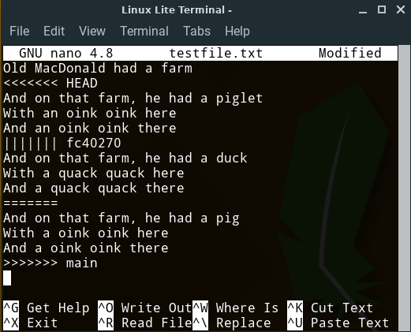
Raw Merge Conflicts
Feature
Branch
“Chevrons”
<<<<<<
>>>>>>
Best Common
Ancestor
main
Branch
Notes:
When a merge conflict occurs
- git will place text directly into the conflicting files
- to represent the conflict
Ask
- What do you think we are seeing here?
- the three versions of the conflicting content
- the feature branch
- the best common ancestor
- the main branch
The conflict is indicated by
- “Chevrons”
- Aligned V shapes
- Often on military uniforms to indicate rank
- also often used for directional road markings.
The other symbols
- ||||||| fc40270
- the SHA of the best common ancestor
- ======
- just a divider before the main branch.
You can simply edit the file:
- Open it in any editor you want
- Make everything between the chevrons look the way you want.
- Just edit it down to the correct blended version.
- Remove the chevrons
- Save and exit

Slide 12
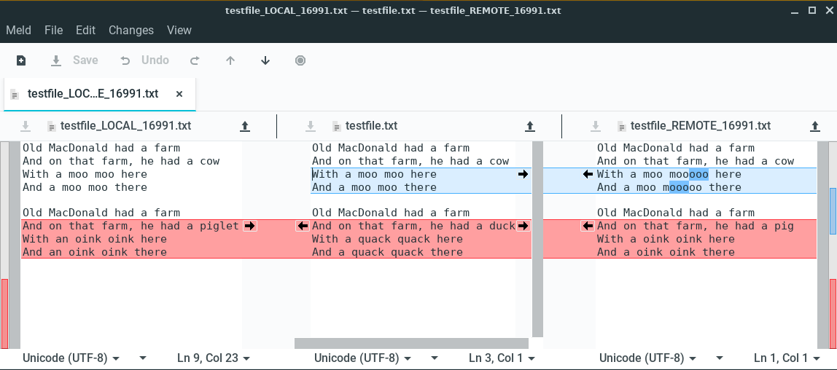
Using a Graphical Merge Tool (e.g. Meld)
Ancestor /
Result
Feature Branch
Main Branch
Notes:
The GUI merge tool will display the same information
In a way that makes it a little easier to work with.
Colors:
- red indicates conflicts
- blue indicates changes but not conflicting
Action:
- Goal is to make the middle pane into what you want
- click arrows
- edit directly
- Save
- Exit
Another nice thing about the GUI tool is if there are multiple conflicts
- the Up and Down arrows at the top
- will move you to the next or previous conflict.
Most IDE’s will have some sort of integrated merge tool.
- Atom, Eclipse, VisualSudio
- whatever you happen to use.
- They all display the same information
- Just in different ways.

Slide 13
Big Picture: Resolving a Merge Conflict
Notes:
Here we just have it all together.
- we already synchronized
- we switch to the feature branch
- perform the merge to resolve the conflict
- Note that this will mean that you have changed the local files!
- Edited them by hand
- or used a GUI tool
- So these changes need to be staged and committed.
- stage the changes
- commit the changes
- push the feature branch
- recall that this will automatically update the PR
- and now it will be able to be merged automatically.
This is where you will want to get to by the end of A10.

Slide 14
Big Picture: The Whole Messy Thing
Notes:
No need to spend much time here.
If you can look at this and remember
- what each of the yellow terms means
- how it relates to the others
- sequence them into a workflow
Then you are in good shape.
- if not keep this handy
- review a little
- make more sense of it little by little.

Slide 15
What’s Next?
A10 – Begin now.
Continue A10/Q10 – 1 week
Revise and resubmits
Reading for discussion

Slide 16

Acknowledgments:
Slide Template From:
https://creativecommons.org/licenses/by/4.0/
Slide Content Licensed as:
https://creativecommons.org/licenses/by-nc/4.0/

